Slide 1
Picture resource
Please use the pictures on the next slide in your presentations for acknowledging SCOP for their contributions to your work.
Contact SCOP (LINK) if you need more information

Slide 2
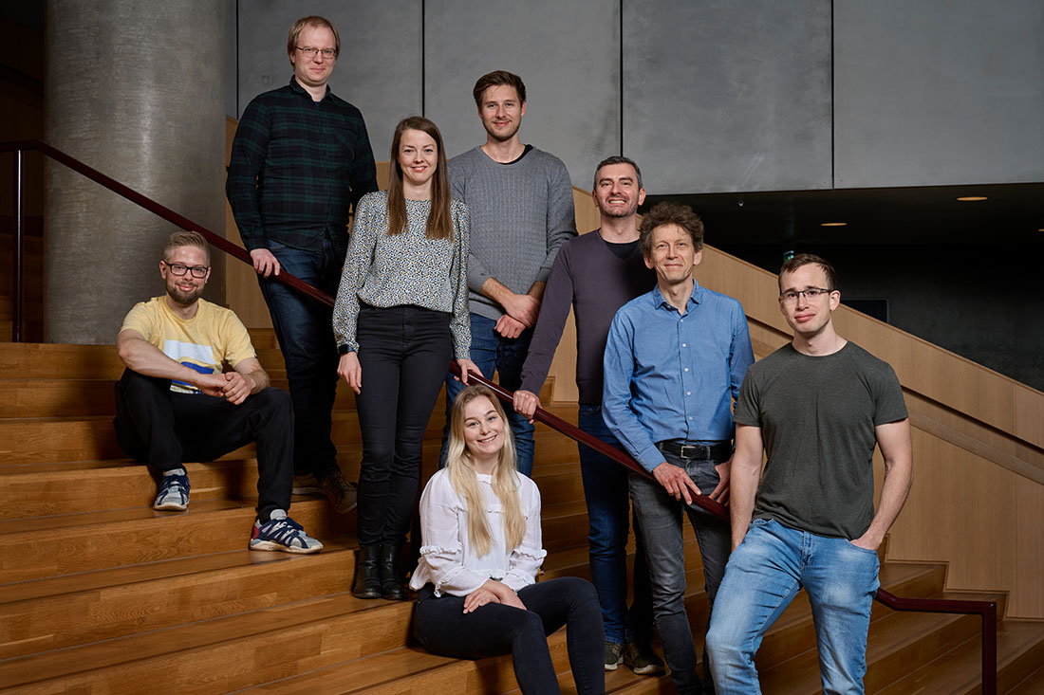
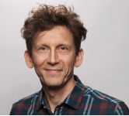
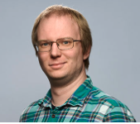
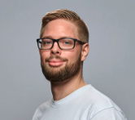
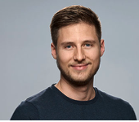
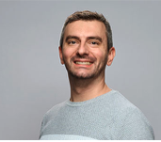
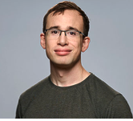
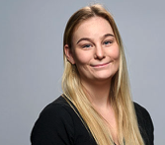
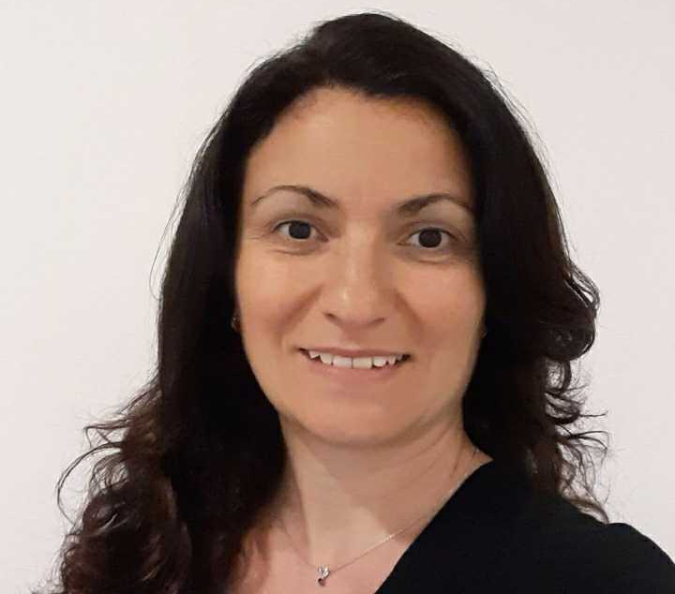
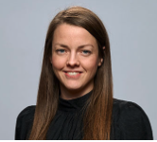
The Single-Cell Omics Platform
Christian Grønbæk
Lars R. Ingerslev
Oliver k. Møller
Thomas G. Koefoed
Geoffroy Durand
Steffen Hentze
Malou Christensen
Claudia Vitrini
Julie M. Ipsen
Mie Mechta

